Slide 1
Software Introduction Workshop
Geoff Spielman - 2017

Slide 2
outline
Installing Python
Installing Sublime (optional)
Python Syntax
Using the Serial Library
Python to Arduino Serial Communication Example
Installing Pygame
Pygame Example

Slide 3
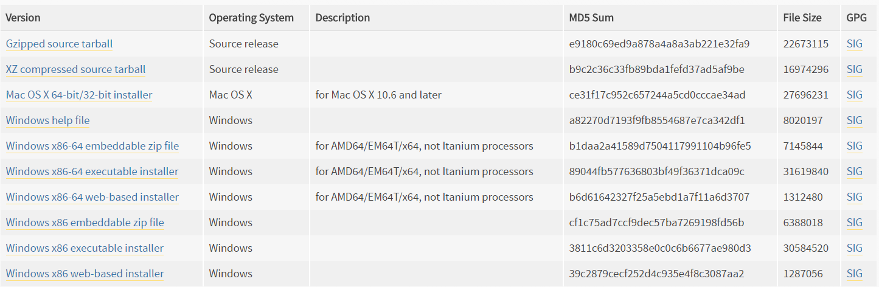
Installing Python
Go to python.org
Click on ‘Latest Python 3 Release”

Slide 4
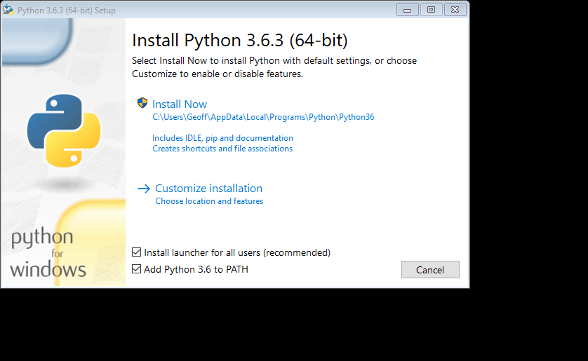
PATH is an environment variable
Specifies the set of directories (folders) were executable programs can be found
When you enter a command or a system call is made to execute a program, the system searches the current working directory and then the path
looking for an executable filename that matches the command name given

Slide 5
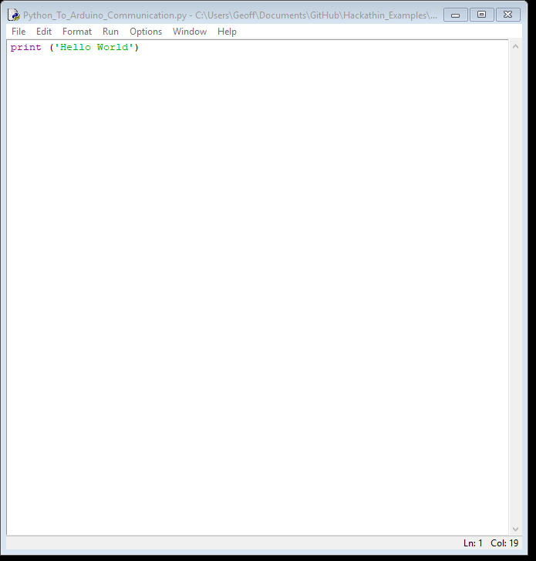
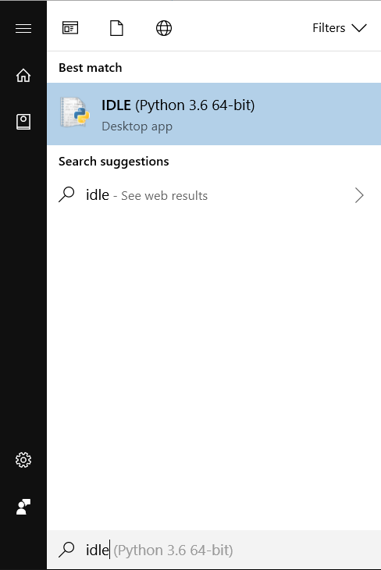

Slide 6
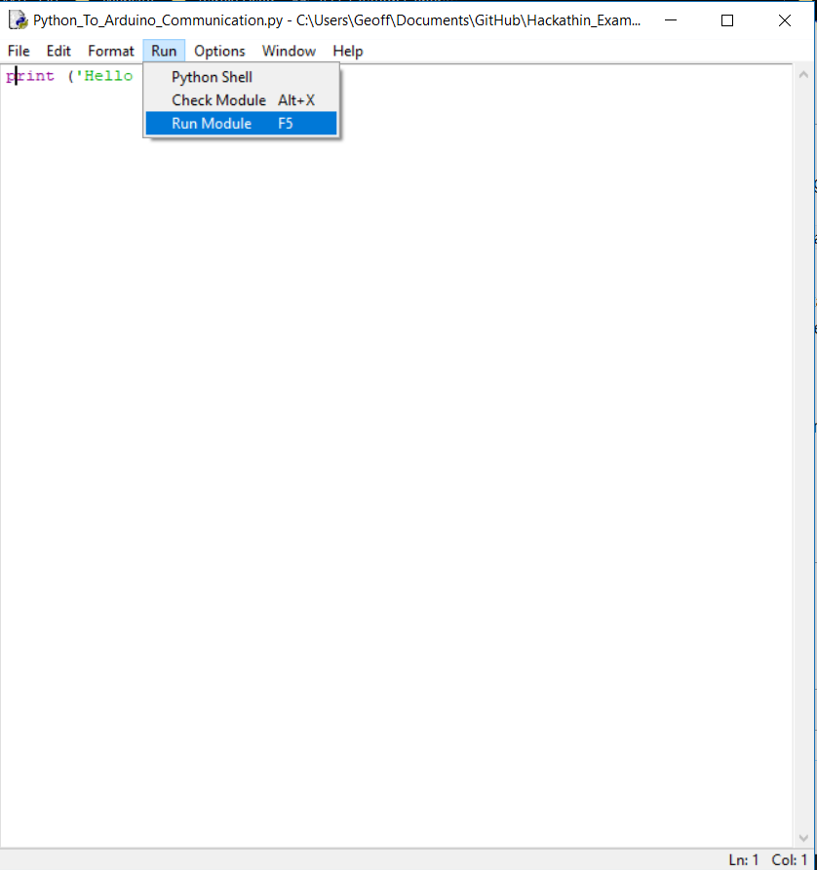
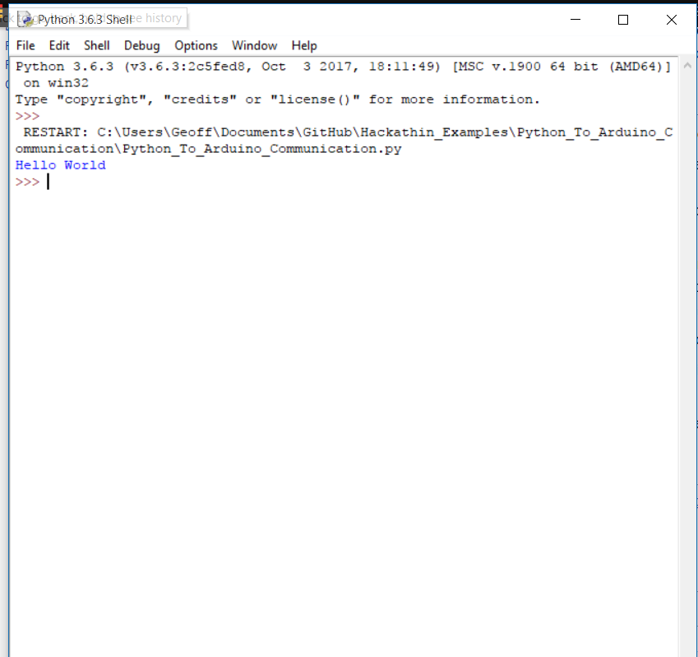
F5

Slide 7
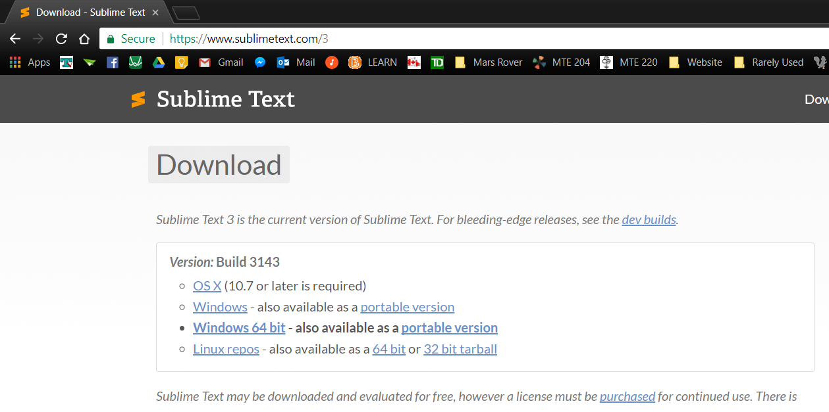
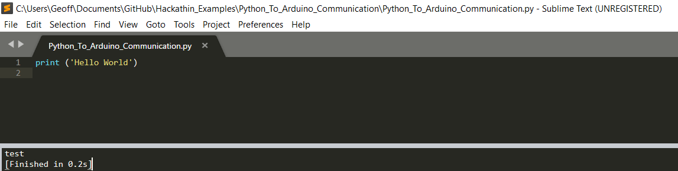
Optional: Install Sublime or another IDE
Ctrl + B

Slide 8
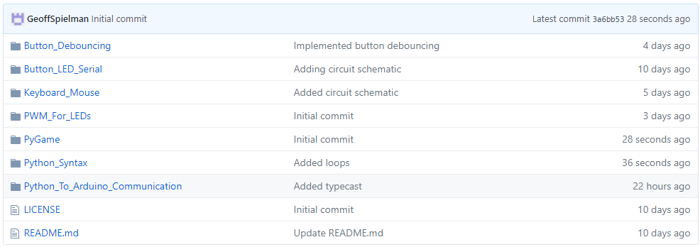
Basic Python Syntax
Go to https://github.com/GeoffSpielman/Hackathin_Examples or search GitHub for “Hackathin_Examples”

Slide 9
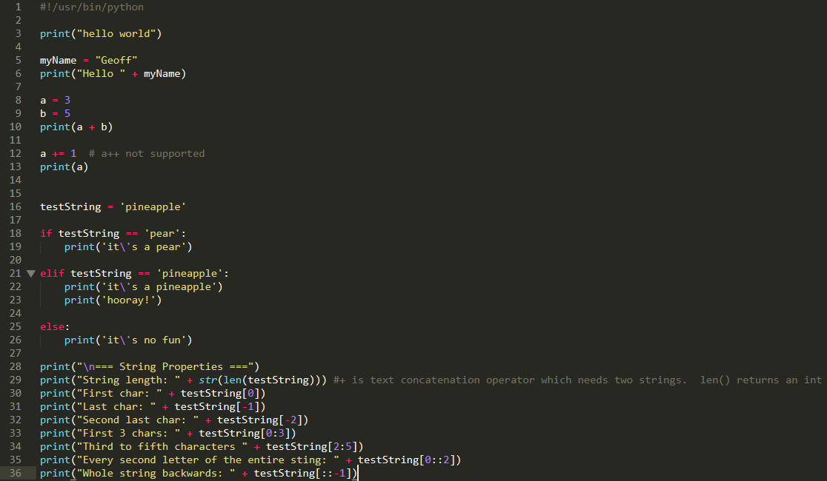
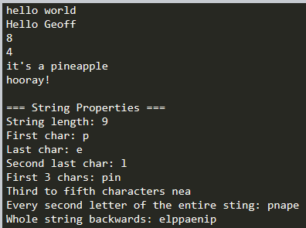
Basic Python Syntax
brackets around print()
variables
escape characters
if statement indenting

Slide 10

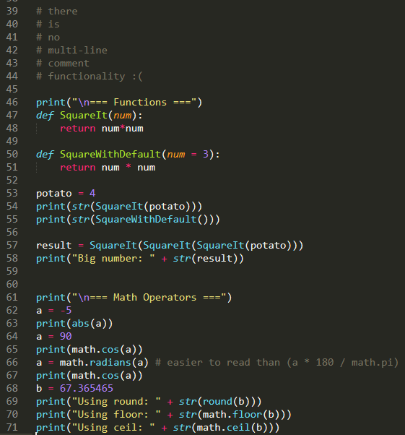
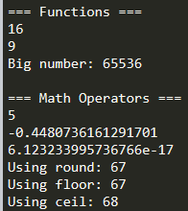
Basic Python Syntax
note the colons!!!!!
Image: http://idtenergy.blogspot.ca/2013/04/vegetable-electricity-potato-power.html

Slide 11
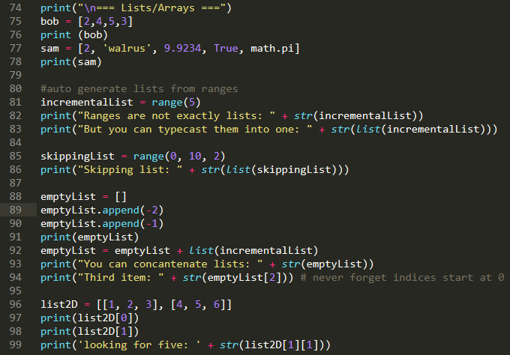
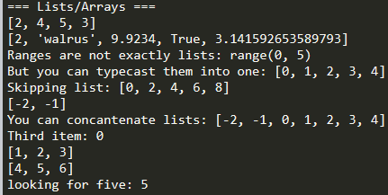
Basic Python Syntax

Slide 12
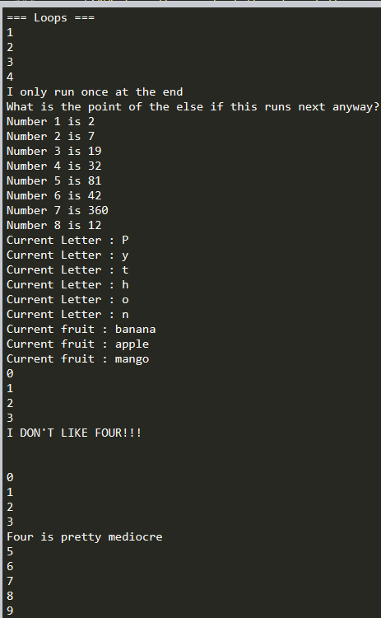
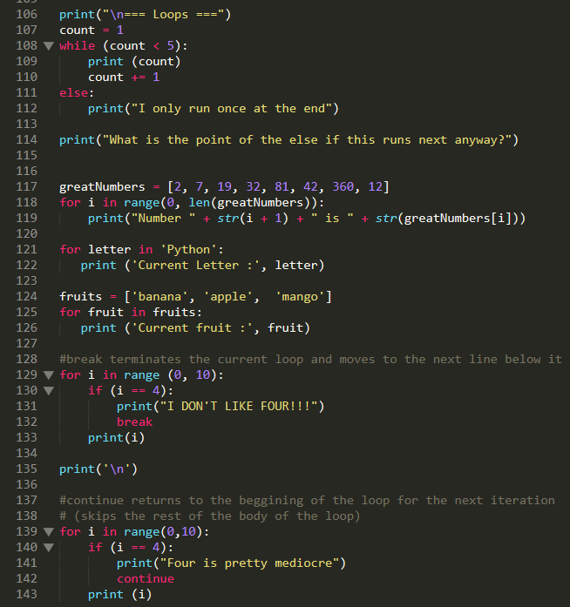
Basic Python Syntax
Don’t need to typecast if it’s simple and no concatenation is required

Slide 13
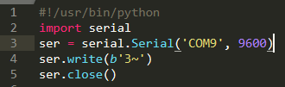
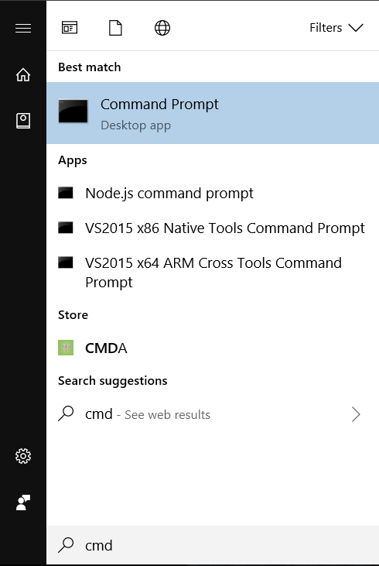
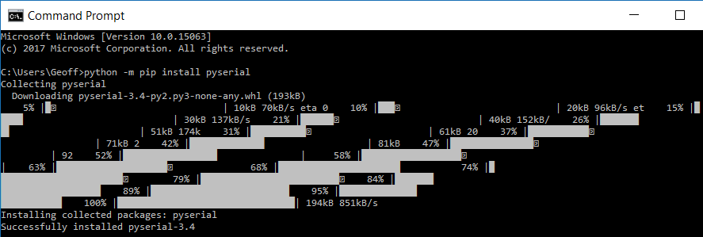
Using the Serial Library
Open the command line
Sidenote: what is pip?
Package management system for python
Lets you install and manage python packages from the Python Package Index (PyPI)
120,211 packages available today
Type “python -m pip install pyserial”

Slide 14
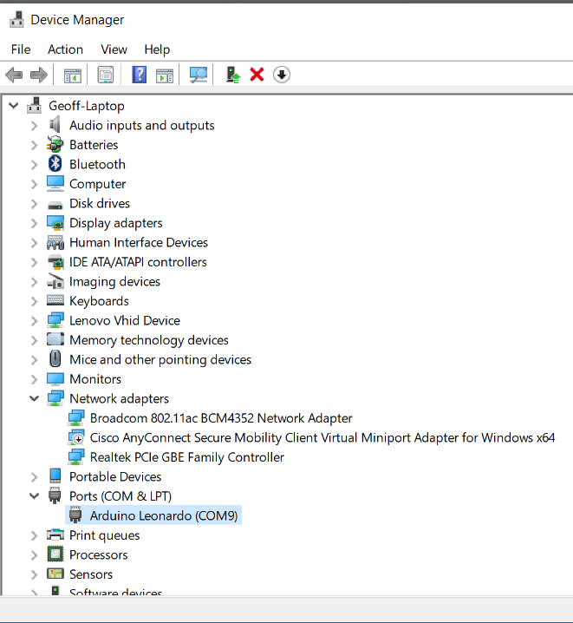
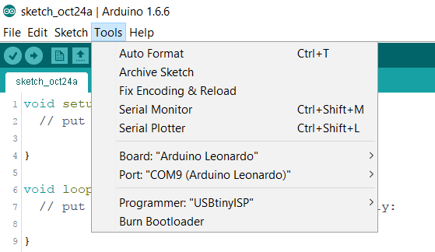
Using the Serial Library
What port is my Arduino connected to?

Slide 15
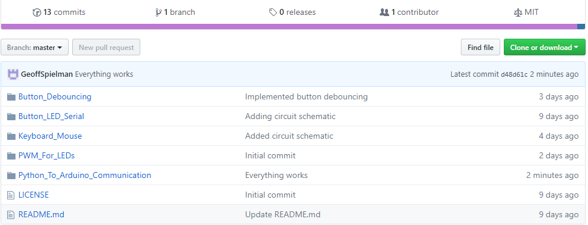
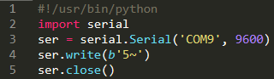
Python Code
Go to https://github.com/GeoffSpielman/Hackathin_Examples or search GitHub for “Hackathin_Examples”

Slide 16
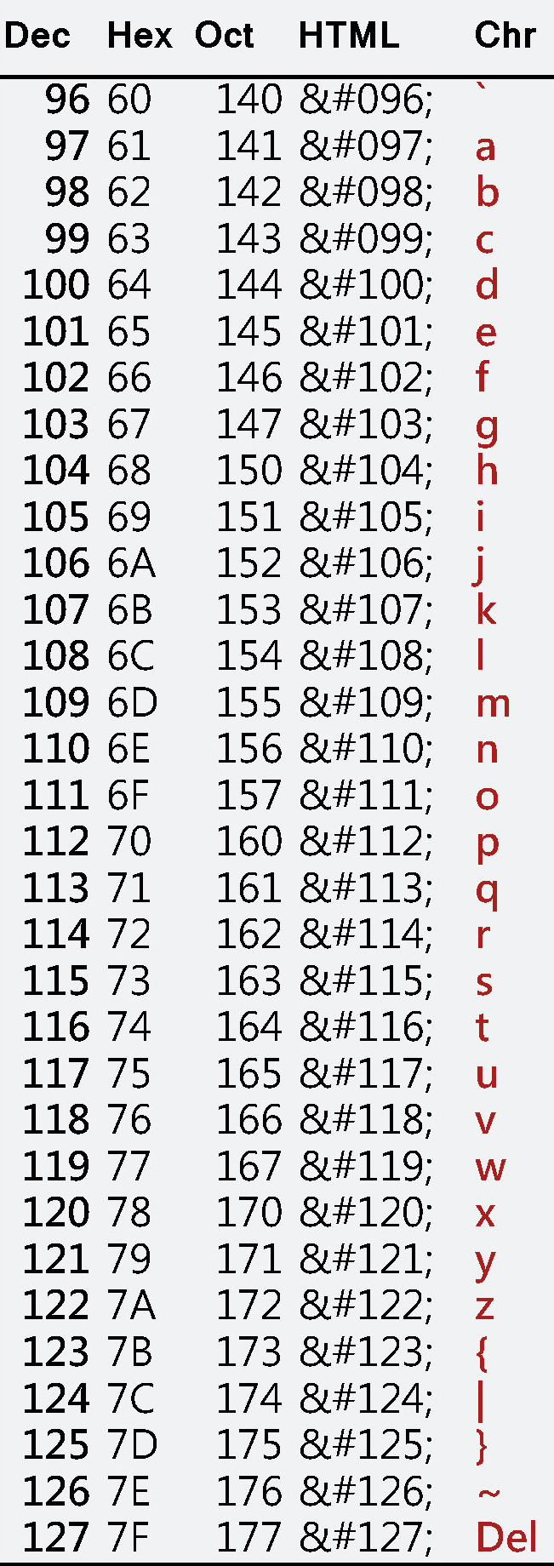
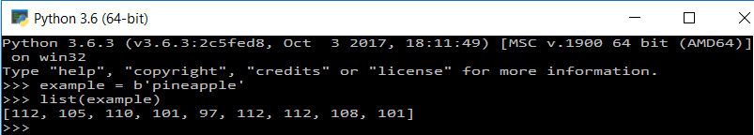
Python Code
‘b’ converts string to a byte array
Array of Unicode ‘code points’
Unicode – unique code point for every character in every language
ASCII – subset of Unicode covering only 128 characters (a-z, A-Z, 0-9, some punctuation and control characters)
Image: http://www.asciichars.com/

Slide 17
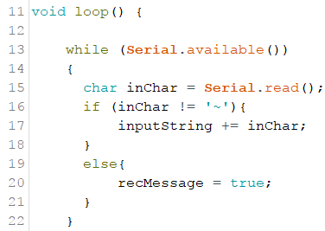
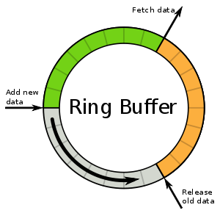
Arduino code
Sidenote: the event ‘serialEvent’ does not work – won’t be triggered
Serial buffer is a circular queue of bytes
Serial.available() returns the number of bytes available to read in the buffer
Image: https://chessprogramming.wikispaces.com/Queue

Slide 18
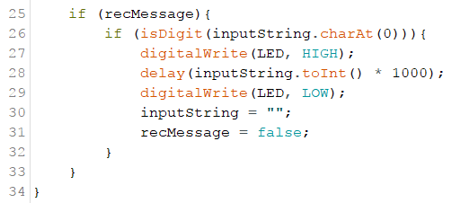





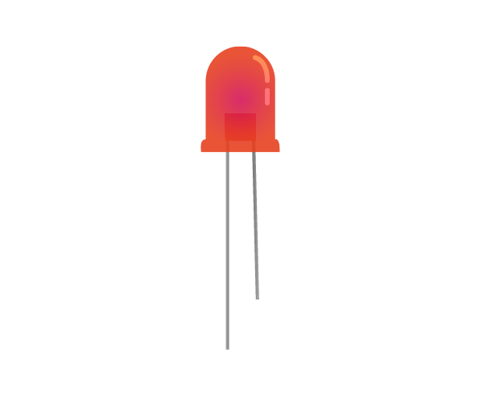

Arduino code
Checks if the first character is a digit and keeps LED on for that many seconds
SERIAL LINE
isDigit() (char)
toInt()
Train: http://cliparting.com/free-train-clipart-6380/
5 seconds
Tracks: https://www.canstockphoto.com/illustration/tracks.html
Gripper: https://www.pinterest.ca/pin/492651646724145885/ LED: https://electronics.stackexchange.com/questions/270037/what-kind-of-led-do-i-need/270048

Slide 19
What is Pygame?
cross-platform set of python modules for creating video games
free and open source python library
includes computer graphics and sound functionalitiy
See https://www.pygame.org/docs/ for tutorials and more info

Slide 20
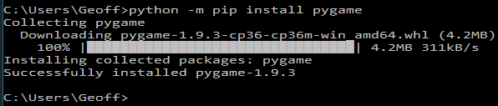
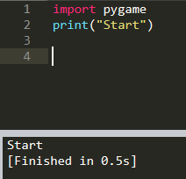
Installing Pygame
Open the command line
Type “python -m pip install pygame”

Slide 21
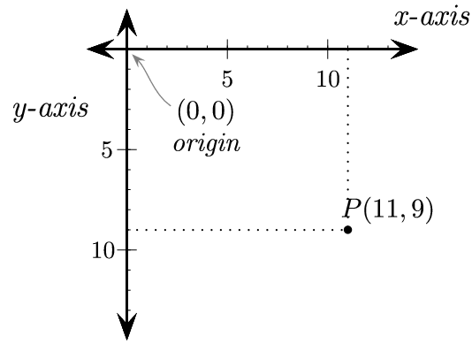
Pygame Example
Image: http://programarcadegames.com/chapters/05_intro_to_graphics/Computer_coordinates_2D.png

Slide 22
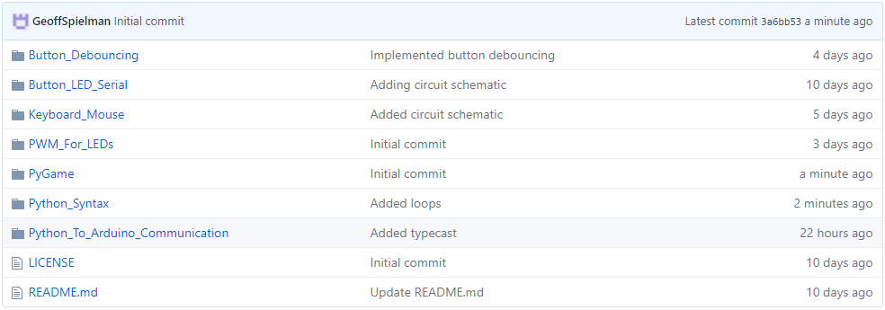
Pygame Example
Go to https://github.com/GeoffSpielman/Hackathin_Examples or search GitHub for “Hackathin_Examples”

Slide 23
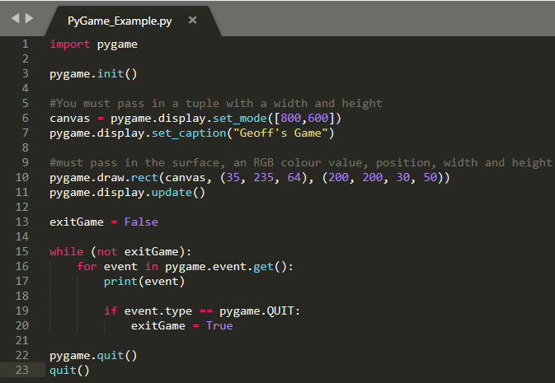
Pygame Example

Slide 24
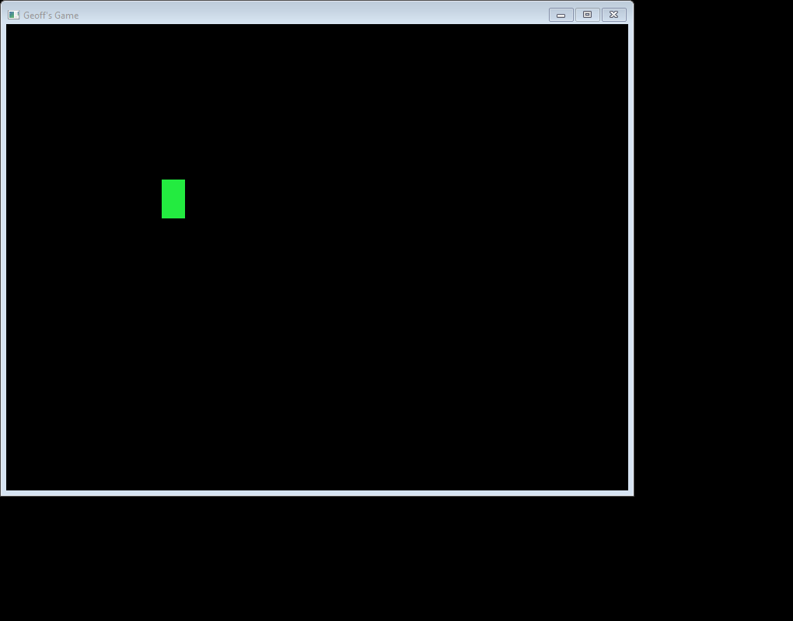
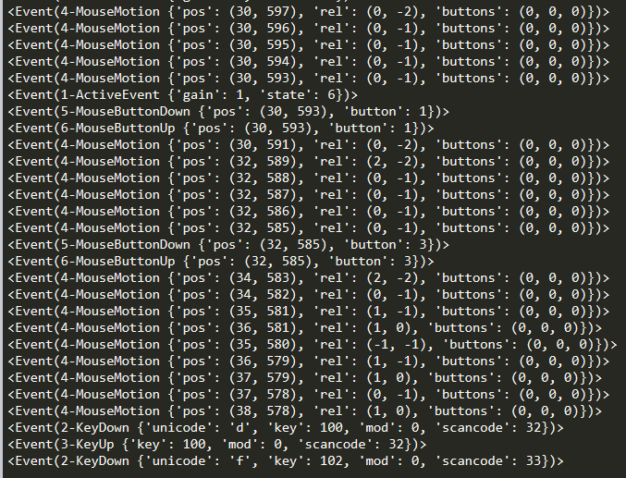
Pygame Example
moving the mouse
Left Click
Right Click
key press

